Slide 1
Looping statements in Java

Slide 2
Repetition Statements
Repetition statements allow us to execute a statement or a block of statements repeatedly until the condition is true.
Often they are referred to as loops.
Like conditional statements, they are controlled by boolean expressions.
Java has three kinds of repetition statements:
while
do
for
The programmer should choose the right kind of loop statement for the situation.
For Loop contain the following statements such as “Initialization”, “Condition” and Increment/Decrement” statement.

Slide 3
Java - For Loop
The Java for loop is used to iterate a part of the program several times. If the number of iteration is fixed, it is recommended to use for loop.
There are three types of for loop in java.
Simple For Loop
For-each or Enhanced For Loop
Labeled For Loop

Slide 4
Java Simple For Loop
The simple for loop is same as C/C++. We can initialize variable, check condition and increment/decrement value.
for(initialization;condition;incr/decr)
{
//code to be executed
}

Slide 5
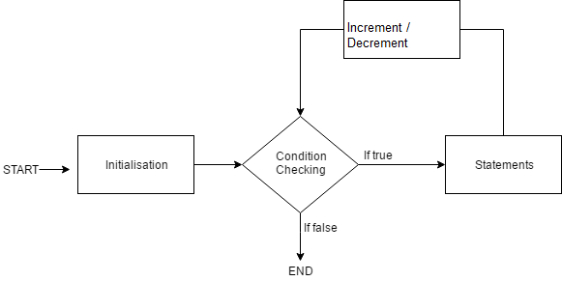

Slide 6
For Loop
Initialization condition: Here, we initialize the variable in use. It marks the start of a for loop. An already declared variable can be used or a variable can be declared, local to loop only.
Testing Condition: It is used for testing the exit condition for a loop. It must return a boolean value. It is also an Entry Control Loop as the condition is checked prior to the execution of the loop statements.
Statement execution: Once the condition is evaluated to true, the statements in the loop body are executed.
Increment/ Decrement: It is used for updating the variable for next iteration.
Loop termination:When the condition becomes false, the loop terminates marking the end of its life cycle.

Slide 7
Example
Output
1
2
3
4
5
6
7
8
9
10
public class ForExample
{
public static void main(String[] args)
{
for(int i=1;i<=10;i++)
{
System.out.println(i);
}
}
}

Slide 8
Java For-each Loop
The for-each loop is used to traverse array or collection in java. It is easier to use than simple for loop because we don't need to increment value and use subscript notation.
It works on elements basis not index. It returns element one by one in the defined variable.
Syntax:
for(Type var:array)
{
//code to be executed
}

Slide 9
Example
public class ForEachExample
{
public static void main(String[] args) {
int arr[]={12,23,44,56,78};
for(int i:arr){
System.out.println(i);
}
}
}
output
12
23
44
56
78

Slide 10
Java - While Loop
The Java while loop is used to iterate a part of the program several times. If the number of iteration is not fixed, it is recommended to use while loop.
Syntax
while(condition)
{
//code to be executed
}

Slide 12
While Loop
While loop starts with the checking of condition. If it evaluated to true, then the loop body statements are executed otherwise first statement following the loop is executed. For this reason it is also called Entry control loop
Once the condition is evaluated to true, the statements in the loop body are executed. Normally the statements contain an update value for the variable being processed for the next iteration.
When the condition becomes false, the loop terminates which marks the end of its life cycle.

Slide 13
Example
public class WhileExample {
public static void main(String[] args) {
int i=1;
while(i<=10){
System.out.println(i);
i++;
}
}
}
Output
1
2
3
4
5
6
7
8
9
10

Slide 14
Java Infinitive While Loop
If you pass true in the while loop, it will be infinitive while loop.
Syntax
while(true){
//code to be executed
}
public class WhileExample2
{
public static void main(String[] args) {
while(true)
{
System.out.println("infinitive while loop");
}
}
}

Slide 15
Java do-while Loop
The Java do-while loop is used to iterate a part of the program several times. If the number of iteration is not fixed and you must have to execute the loop at least once, it is recommended to use do-while loop.
The Java do-while loop is executed at least once because condition is checked after loop body and therefore is an example of Exit Control Loop.
Syntax:
do{
//code to be executed
}
while(condition);

Slide 16
Flow chart

Slide 17
Example
Output
1
2
3
4
5
6
7
8
9
10
public class DoWhileExample {
public static void main(String[] args) {
int i=1;
do{
System.out.println(i);
i++;
}while(i<=10);
}
}

Slide 18
Java Infinitive do-while Loop
syntax
do{
//code to be executed
}while(true);
public class DoWhileExample2 {
public static void main(String[] args) {
do{
System.out.println("infinitive do while loop");
}while(true);
}
}

Slide 19
Java Break Statement
The Java break is used to break loop or switch statement. It breaks the current flow of the program at specified condition. In case of inner loop, it breaks only inner loop.
Syntax:
jump-statement;
break;

Slide 20
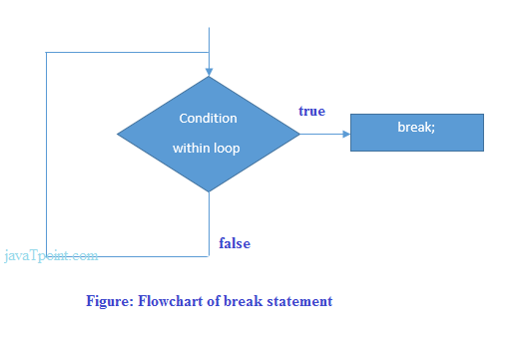
Flow chart

Slide 21
Java Break Statement with Loop
1 2 3 4
1 2 3 4
public class BreakExample {
public static void main(String[] args) {
for(int i=1;i<=10;i++){
if(i==5){
break;
}
System.out.println(i);
}
}
}
Output
1
2
3
4

Slide 22
Java Continue Statement
The Java continue statement is used to continue loop. It continues the current flow of the program and skips the remaining code at specified condition. In case of inner loop, it continues only inner loop.
Syntax
jump-statement;
continue;
public class ContinueExample {
public static void main(String[] args) {
for(int i=1;i<=10;i++){
if(i==5){
continue;
}
System.out.println(i);
}
}
}
Output
1 2 3 4 5 6 7 8 9 10

Slide 23
Pitfalls of Loops
//Java program to illustrate various pitfalls. public class LooppitfallsDemo { public static void main(String[] args) { // infinite loop because condition is not apt // condition should have been i>0. for (int i = 5; i != 0; i -= 2) { System.out.println(i); } int x = 5; // infinite loop because update statement is not provided. while (x == 5) { System.out.println("In the loop"); } } }
Infinite loop: One of the most common mistakes while implementing any sort of looping is that that it may not ever exit, that is the loop runs for infinite time. This happens when the condition fails for some reason.

Slide 24
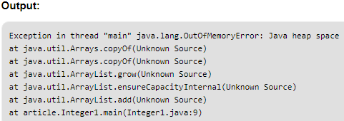
Pitfalls of Loops
//Java program for out of memory exception. import java.util.ArrayList; public class Integer1 { public static void main(String[] args) { ArrayList<Integer> ar = new ArrayList<>(); for (int i = 0; i < Integer.MAX_VALUE; i++) { ar.add(i); } } }
Another pitfall is that you might be adding something into you collection object through loop and you can run out of memory. If you try and execute the below program, after some time, out of memory exception will be thrown.

Slide 25
End of Session - 4 Thank You !

